Slide 1
Exporting and Using Quantum Measurement Data
IBM Quantum + Qiskit

Slide 2
Learning Goals
Export quantum measurement data
Use data in Python programs
Apply data in optimization and machine learning
Build hybrid workflows

Slide 3
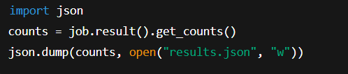
Exporting Measurement Data
Results from IBM Quantum saved in job results
Use Qiskit’s job.result().get_counts()
Convert to JSON or CSV for external use
Example:

Slide 4
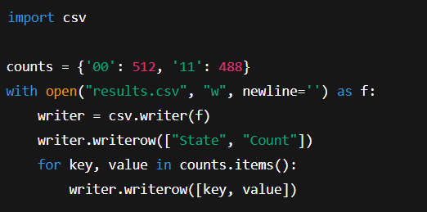
CSV Export Example

Slide 5
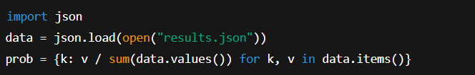
Using Results in Python
Load JSON/CSV
Normalize probabilities
Use as features or input for ML/optimization

Slide 6
Optimization Integration
Use measurement probabilities as solution candidates
Example: QAOA for MaxCut
Hybrid loop: classical optimizer updates quantum parameters

Slide 7
ML Integration
Use quantum outputs as features
Combine with scikit-learn models
Example: classify output patterns

Slide 8
Mini-Projects Ideas
Export Grover results and visualize success rate
Use QAOA output for graph optimization
Build hybrid QML model (quantum kernel + SVM)

Slide 9
Hybrid Workflow Structure
Build quantum circuit
Run on IBM backend
Export results
Process results in Python
Train ML model or optimize objective

Slide 10
Summary
Exporting results = data portability
Integration = practical hybrid workflows
Foundation for quantum-classical research

